Slide 1
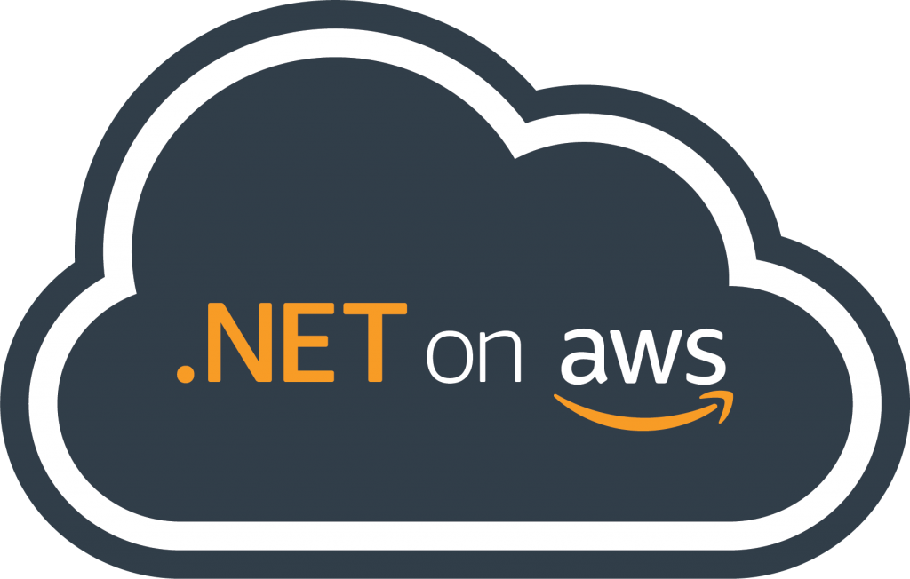



Building and Running .NET Apps on the Cloud Choose your own adventure
Isaac Levin
.NET Developer Advocate
@isaacrlevin

Slide 2
What .NET developers ask me about AWS
Does AWS support .NET?
Does AWS provide tools for .NET developers?
How can I host my .NET application on AWS?
How can I containerize my .NET application?
How can I move from .NET Framework to .NET?
How can I break my .NET monolith?

Slide 3
The most important key takeaway
.NET

Slide 4
Does AWS support .NET?

Slide 5
AWS Toolkit for Visual Studio 2022
Microservice Extractor for .NET
Never ending commitment to .NET
Core WCF Contributor
ARM64 support with Graviton2
AWS .NET deployment tool
Porting Assistant for .NET
AWS Elastic Beanstalk with .NET 5
.NET Core 3.1 on Lambda
App2Container
Amplify CLI .NET support
.NET Lambda base image
AWS Toolkit for Rider
AWS Elastic Beanstalk with .NET Core 3.1
AWS Toolkit for Visual Studio Code
AWS CDK with .NET
Windows Server 2019
Lambda Support for PowerShell Core
Lambda Layers
Dedicated Host Enhancement Tag-On
Windows Server 1803
SQL Server 2019
Sessions Manager
AWS X-Ray .NET Core Support
EC2 Windows on Bare Metal/Hyper-V AMI
DynamoDB Accelerator SDK for .NET
Hyper-V support in SMS
.NET Core 2.1 Linux AMIs
Customer Adoption
Windows Deep Learning AMI
SQL 2017 AMI AL2/Ubuntu
Application-consistent Snapshots through VSS
.NET Core & PowerShell on AL2/Ubuntu
SQL Server 2017
.NET Core 2.1 on Lambda
.NET on Lambda & Codebuild
Windows for Lightsail
Trusted Advisor checks for Windows
EC2 Systems Manager
X-Ray .NET SDK
Microsoft SharePoint 2016 (Marketplace)
Amazon ECS for Windows Containers
EC2 Dedicated Hosts (BYOL)
Windows Server 2016
AWS Directory Service
SQL Server 2016
Windows Server & EC2
EC2 Dedicated Instances (BYOL)
Windows Server 2012
EC2 Run Command
SQL Server
Windows
Server 2003
Windows
Server 2008 R2
SQL Server 2012
Microsoft SCVMM Plug-in
AWS Tools for Windows PowerShell
.NET
SQL Server 2005
SQL Server 2008 R2
Amazon RDS adds SQL Server
App Modernization
Microsoft SCOM plug-in release
Toolkit for Visual Studio
SDK for .NET
WS 2008 & SQL Server 2008
2008
2010
2012
2014
2016
2018
2020
Today

Slide 6
Does AWS provide tools for .NET developers?

Slide 7
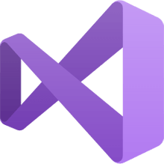

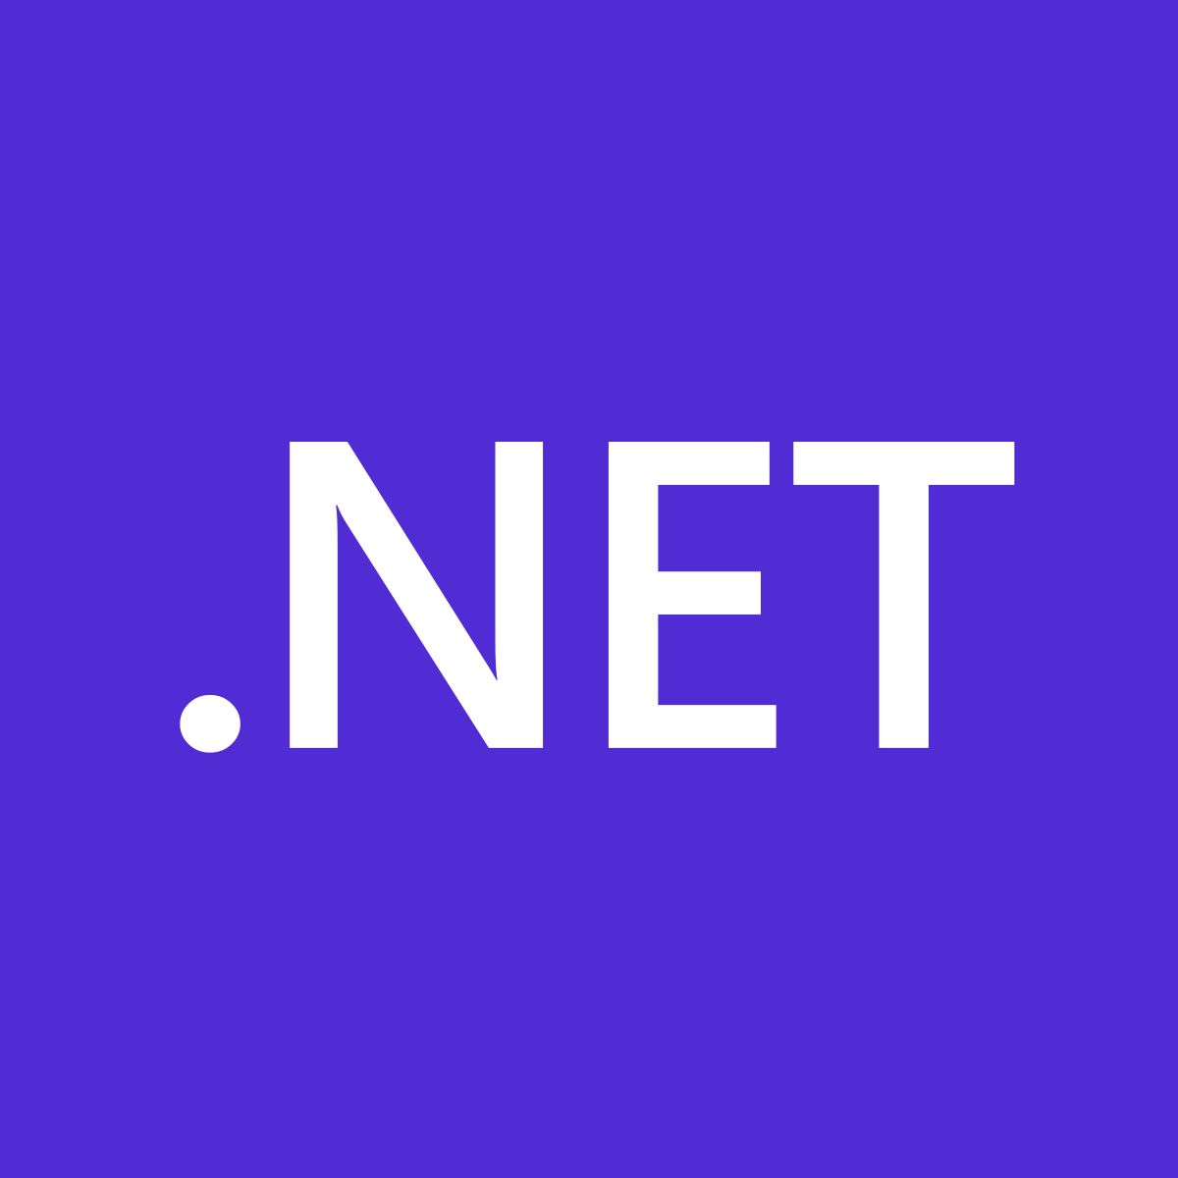

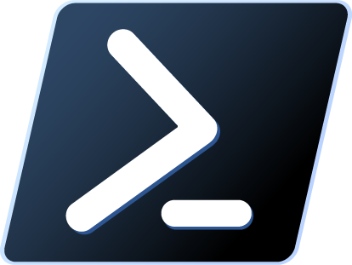
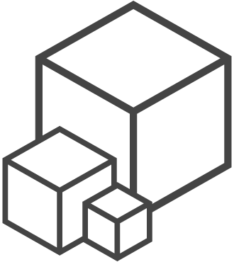
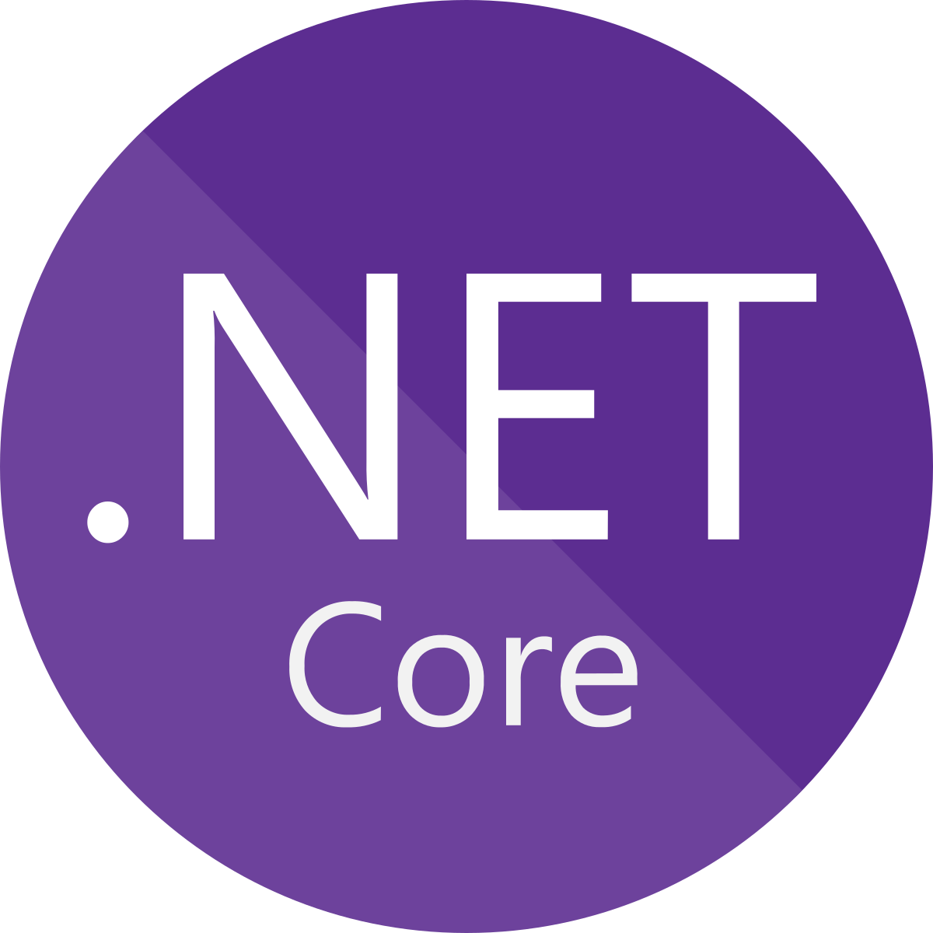
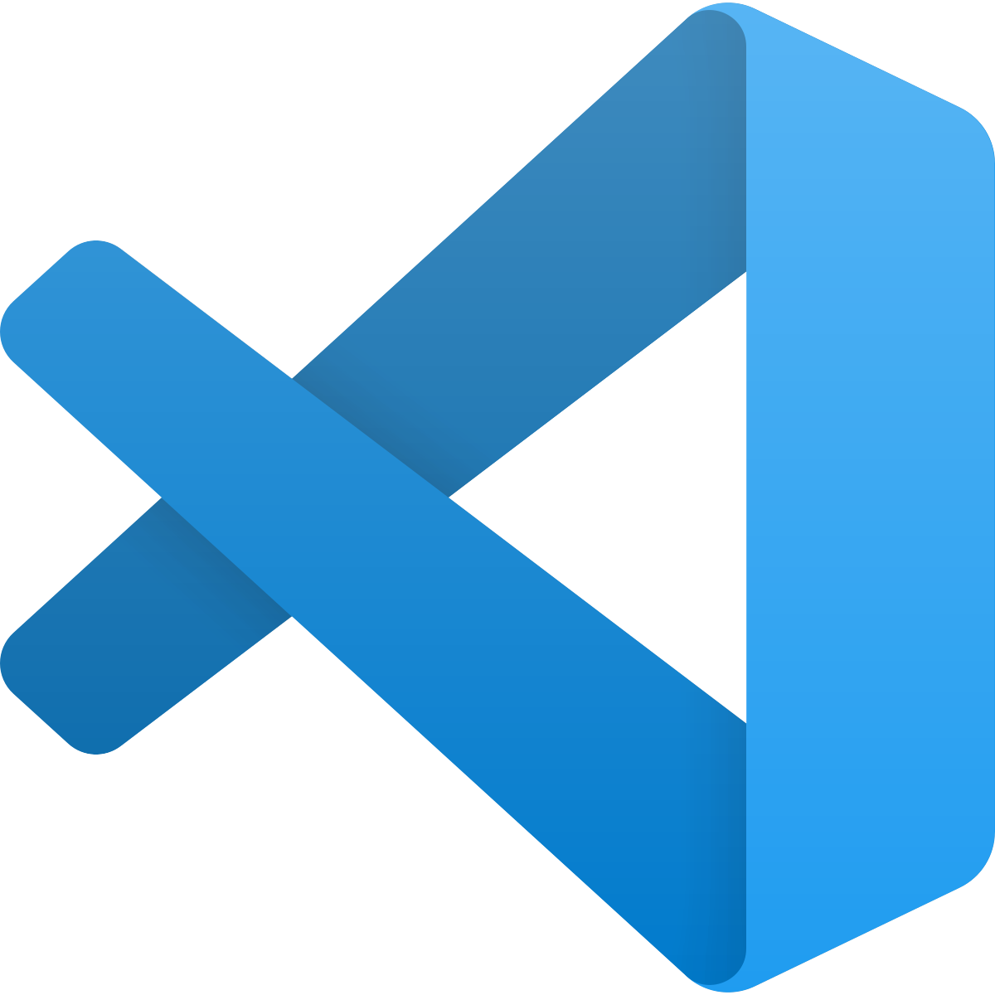
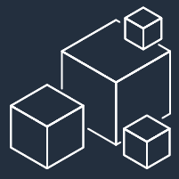

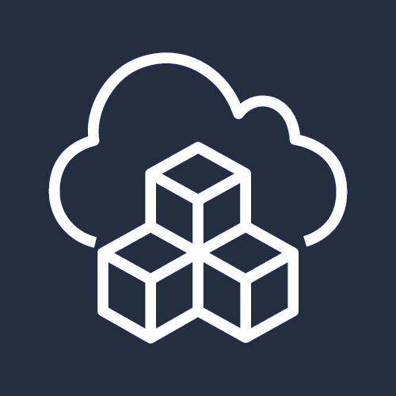
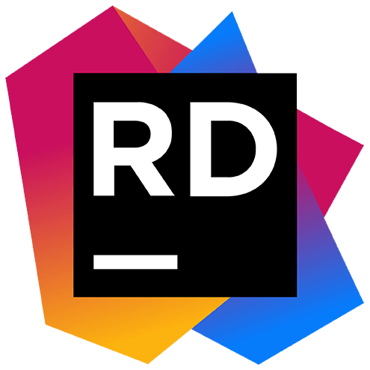
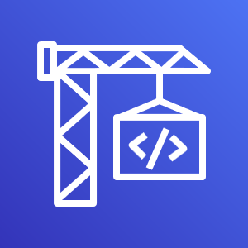

Development Tools
IDE Integration
Programmable SDK
Command Line Tools
CI/CD Integration
Migration / Modernization
Tools
AWS Toolkit for Visual Studio
AWS SDK for .NET
AWS Tools for Azure DevOps
App2Container
AWS Tools for PowerShell
‘dotnet’ CLI extensions
AWS Toolkit for Visual Studio Code
Porting
Assistant
for .NET
AWS CodePipeline/ CodeBuild
AWS CLI
AWS SAM
AWS CDK for .NET
AWS Toolkit for Rider
Microservice Extractor
for .NET
Notes:
AWS has supported .NET and PowerShell for many years and makes available a collection of free tools and IDE integrations that you can use to develop, deploy, and manage your applications and their resources in the cloud.
Integrations with Visual Studio, Visual Studio Code, and JetBrains Rider make working with AWS services from within IDE environments easy and convenient.
To integrate calls to AWS services from within your applications, use the AWS SDK for .NET.
The SDK makes calling an AWS service API as simple as calling a method on an object.
For defining cloud infrastructure and resources for your applications, there’s also the AWS Cloud Development Kit or CDK.
With the CDK, you define your resources in the programming languages you use every day, for example C#, instead of using a declarative templating language such as YAML or JSON.
A rich collection of PowerShell modules wrapping AWS services is available for command line and scripting users, and you can also use .NET and PowerShell to write your serverless functions and applications for use with AWS Lambda.
For .NET Core, and .NET 5 or higher, tooling packages are available that integrate with the dotnet command line interface.
The AWS Command Line Interface, or AWS CLI and the AWS Serverless Application Model, or SAM, CLI can also be used with .NET.
Today, many organizations and developers make use of continuous integration and deployment and AWS offers a suite of services you can use for build and deployment, and pipeline orchestration.
There’s also an integration for users with established CI/CD pipelines in Azure DevOps looking to bridge that last mile to AWS.
You’ll also find free tools that can assist with application migration and modernization.
App2Container encapsulates your legacy application into a container, complete with the application dependencies.
The Porting Assistant for .NET can help you port your .NET Framework applications to .NET Core and .NET 5.
And finally, the Microservice Extractor for .NET helps with refactoring your monolithic MVC applications to a microservices architecture for better scale, more resiliency, and faster development.

Slide 8
How can I host my .NET application on AWS?

Slide 9

.NET Application Migration
How can I host my .NET application on AWS?
Target VM
or
Container / Serverless ?
VM
AWS Managed
or Self-Managed ?
Self
Amazon EC2

Slide 10
Amazon EC2
Virtual server instances in the cloud
CATEGORIES
CAPABILITIES
OPTIONS
Choice of processor (AWS, Intel, AMD)
Fast processors (up to 4.0 GHz)
High memory footprint (up to 24 TiB)
Instance storage (HDD and SSD)
Accelerated computing (GPUs and FPGA)
Networking (up to 100 Gbps)
Bare Metal
Size (Nano to 48xlarge – 192vCPU)
General purpose
Burstable
Compute intensive
Memory intensive
Storage (High I/O)
Dense storage
GPU compute
Graphics intensive
MORE THAN
Amazon EBS
Amazon Elastic Inference
400+
INSTANCE TYPES
for virtually every workload and business need
Notes:
1/ For all different kinds of workloads, we offer different capabilities, processors, platforms, instances, and more.
2/ All these options create the power of choice for our customers to select the best instances for their business needs.
Amazon EC2: les instances démarrent vite et ça incite vraiment à faire du try & delete

Slide 11
AWS Graviton Processor
Best price performance in ec2
CAPABILITY
HOW MUCH FASTER?
Compute Performance
Floating-point performance
Cryptographic Workload Performance
Vector-instruction performance
25% better
2x higher
2x higher
35% higher
Notes:
1/ For all different kinds of workloads, we offer different capabilities, processors, platforms, instances, and more.
2/ All these options create the power of choice for our customers to select the best instances for their business needs.
Amazon EC2: les instances démarrent vite et ça incite vraiment à faire du try & delete

Slide 12

.NET Application Migration
How can I host my .NET application on AWS?
Target VM
or
Container / Serverless ?
VM
AWS Managed
or Self-Managed ?
AWS Elastic Beanstalk
managed EC2
Self
Amazon EC2

Slide 13
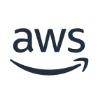






AWS Elastic Beanstalk
A fully managed service for hosting web applications
myapp.com
AWS Cloud
Amazon Route 53
Availability Zone 1
Availability Zone 2
Highly available
Scalable
Provisioned automatically
VPC
Elastic Beanstalk
environment
Application load balancer
Auto Scaling Group
Web server
instances
Web server
instances
Notes:
We all want that our web applications are highly available and scalable.
OK, what we have to do to achieve this goal:
Add an application load balancer
That routes the request to web server instances in at least 2 Availability Zones (2 independent datacenters in the same region)
Add an auto scaling group to manage the addition or retirement of web server instances
That’s a lot of AWS resources to manage. This is where Elastic Beanstalk brings its value: it provisions and manages these resources for you. You still have access to the underlying resources as it is plain-old EC2 instances, Load Balancer and Auto Scaling Group

Slide 14
.NET Application Migration
How can I host my .NET application on AWS?
Target VM
or
Container / Serverless ?
.NET Framework or .NET ?
Container / Serverless
Rehost
VM
.NET Framework
AWS Managed
or Self-Managed ?
Serverless Containers ?
AWS Elastic Beanstalk
managed EC2
No
Self
Orchestration by
Kubernetes ?
Amazon EC2
Amazon EKS hosting managed Windows Containers
Yes

Slide 15

Amazon EKS
Open flexibility
GitLab, Jenkins
GitHub
Jenkins
Flux
DockerHub/ ECR Public
Team
Prometheus, Grafana
[New AWS managed options for both]
ALB, NLB, NGINX, Traefik
User
Application
Istio, LinkerD, AWS App Mesh
AWS Controllers for Kubernetes (ACK)
EKS
Terraform
EC2
Notes:
We recognize that you might not be starting from scratch when you build on AWS container services. You may have chosen Kubernetes as the core of and have existing tooling. EKS give you the ability to bring the services you want and build in a flexible environment.
Of course, if you want to use EKS with all of the AWS services, you can do that too, and we continue to prioritize Kubernetes-friendly integrations with innovations like ACK (AWS controllers for Kubernetes).
SPEAKERS NOTE: Go into as much depth as you think appropriate on this slide

Slide 16

.NET Application Migration
How can I host my .NET application on AWS?
Target VM
or
Container / Serverless ?
.NET Framework or .NET ?
Container / Serverless
Rehost
VM
.NET Framework
AWS Managed
or Self-Managed ?
Serverless Containers ?
AWS Elastic Beanstalk
managed EC2
No
Self
Orchestration by
Kubernetes ?
No
Amazon EC2
Amazon ECS hosting managed Windows Containers
Amazon EKS hosting managed Windows Containers
Yes

Slide 17
Amazon ECS
Powerful simplicity
CodePipeline
CodeCommit
CodeBuild
CodeDeploy
ECR
Team
CloudWatch
ALB
User
Application
App Mesh
ECS
CloudFormation
EC2
Notes:
We recognize that you might not be starting from scratch when you build on AWS container services. You may have chosen Kubernetes as the core of and have existing tooling. EKS give you the ability to bring the services you want and build in a flexible environment.
Of course, if you want to use EKS with all of the AWS services, you can do that too, and we continue to prioritize Kubernetes-friendly integrations with innovations like ACK (AWS controllers for Kubernetes).
SPEAKERS NOTE: Go into as much depth as you think appropriate on this slide

Slide 18
.NET Application Migration
How can I host my .NET application on AWS?
Target VM
or
Container / Serverless ?
.NET Framework or .NET ?
Container / Serverless
Rehost
VM
.NET Framework
AWS Managed
or Self-Managed ?
Serverless Containers ?
AWS Elastic Beanstalk
managed EC2
Yes
AWS Fargate with ECS managed Windows containers
No
Self
Orchestration by
Kubernetes ?
No
Amazon EC2
Amazon ECS hosting managed Windows Containers
Amazon EKS hosting managed Windows Containers
Yes

Slide 19
AWS Fargate
Serverless Compute Engine For Containers
CodePipeline
CodeCommit
CodeBuild
CodeDeploy
ECR
Team
CloudWatch
ALB
User
Application
App Mesh
ECS
CloudFormation
Fargate
Notes:
We recognize that you might not be starting from scratch when you build on AWS container services. You may have chosen Kubernetes as the core of and have existing tooling. EKS give you the ability to bring the services you want and build in a flexible environment.
Of course, if you want to use EKS with all of the AWS services, you can do that too, and we continue to prioritize Kubernetes-friendly integrations with innovations like ACK (AWS controllers for Kubernetes).
SPEAKERS NOTE: Go into as much depth as you think appropriate on this slide

Slide 20
.NET Application Migration
How can I host my .NET application on AWS?
Target VM
or
Container / Serverless ?
.NET Framework or .NET ?
Linux or Windows ?
Containerized Applications or Serverless Functions ?
Container / Serverless
.NET
Linux
Rehost
AWS App Runner
VM
.NET Framework
Serverless Containers ?
Containerized applications
AWS Managed Containerized Web/API Applications ?
Serverless Containers ?
Windows
AWS Managed
or Self-Managed ?
Yes
AWS Elastic Beanstalk
managed EC2
Yes
Yes
No
AWS Fargate with ECS managed Windows containers
No
No
Self
Orchestration by
Kubernetes ?
Orchestration by
Kubernetes ?
Orchestration by
Kubernetes ?
No
No
Amazon EC2
Amazon ECS hosting managed Windows Containers
No
Amazon ECS hosting managed Linux Containers
Yes
AWS Fargate with ECS managed Linux containers
AWS Fargate with EKS managed Linux containers
Amazon EKS hosting managed Windows Containers
Yes
Yes
Amazon EKS hosting managed Linux Containers

Slide 21
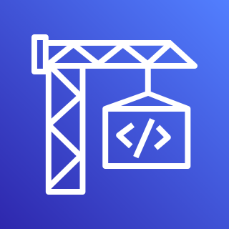

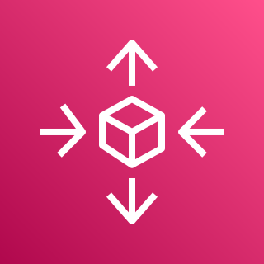
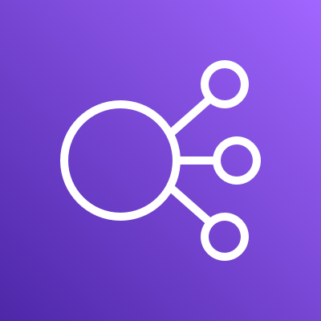
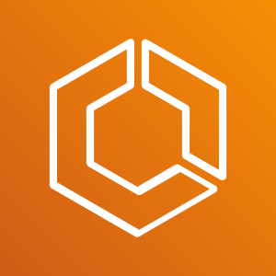
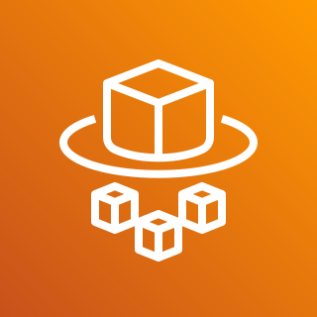
AWS App Runner
Fully managed service for Web application and API hosting Services
AWS App Runner
AWS CodeBuild
AWS Auto Scaling
Elastic Load Balancing
Serverless Platform
ECS
provides a highly abstracted
and simple managed experience for running
web applications and API hosting services
AWS Fargate
Notes:
But, when they get to the cloud they start finding that there's all these different infrastructure layers that they have to learn.
Starting from the bottom with the compute layer they would have to learn Fargate to provision, configure, or scale clusters of virtual machines.
To run containers they may then have to be able to operate ECS as an orchestrator
They need to have a load balancer for their applications to distribute and make their processing efficient. So now, they're learning and equipping around ELBs.
Not to forget, they need to handle that scaling piece that we just called out, they've got to determine those metrics what they're going to scale on and off of and figure out what their application needs for that for that workload and then CICD pipelines and other operational pieces.
So we often hear customers say, hey, there's a big learning curve here.
“I have to learn a lot about these infrastructure services when I'm really focused on my web application, my back end servers, I want to go and deploy these apps.
How can I skip the hassle of learning all these specifics? “

Slide 22

.NET Application Migration
How can I host my .NET application on AWS?
Refactor
Target VM
or
Container / Serverless ?
.NET Framework or .NET ?
Linux or Windows ?
Containerized Applications or Serverless Functions ?
Container / Serverless
AWS Lambda
.NET
Linux
Serverless Functions
Rehost
AWS App Runner
VM
.NET Framework
Applications
Windows
Serverless Containers ?
AWS Managed Containerized Web/API Applications ?
AWS Managed
or Self-Managed ?
Serverless Containers ?
Yes
AWS Elastic Beanstalk
managed EC2
Yes
Yes
No
AWS Fargate with ECS managed Windows containers
No
No
Replatform
Self
Orchestration by
Kubernetes ?
Orchestration by
Kubernetes ?
Orchestration by
Kubernetes ?
No
No
Amazon EC2
Amazon ECS hosting managed Windows Containers
No
Amazon ECS hosting managed Linux Containers
Yes
AWS Fargate with ECS managed Linux containers
AWS Fargate with EKS managed Linux containers
Amazon EKS hosting managed Windows Containers
Yes
Yes
Amazon EKS hosting managed Linux Containers

Slide 23
AWS Lambda
Serverless event-driven code execution
AWS manages
Customer manages
Least
AWS Lambda
Serverless functions
Data source integrations
Physical hardware, software, networking, and facilities
Provisioning
Application code
AWS Fargate
Serverless containers
Container orchestration, provisioning
Cluster scaling
Physical hardware, host OS/kernel, networking, and facilities
Application code
Data source integrations
Security config and updates
Network config
Management tasks
What you manage
Amazon ECS/EKS Container-management -as-a-service
Container orchestration control plane
Physical hardware software, networking, and facilities
Application code
Data source integrations
Work clusters
Security config and updates, network config, firewall, management tasks
Amazon EC2
Infrastructure-as-a-Service
Application code
Data source integrations
Scaling
Security config and updates
Network config
Management tasks
Provisioning, managing scaling and patching of servers
Physical hardware software, networking, and facilities
Most
Notes:
For many customers – their first decision when it comes to application architecture is compute.
1/ You can start at the very bottom with EC2 and have access to all the knobs you want to manage or you could go completely serverless with lambda where you’re focusing just on your application.
2/ So the layers of abstractions available to you with AWS is super empowering because your teams have the choice to pick the layer of abstraction they’re most comfortable with and we will provide you the tools, services, and APIs necessary to help you build your application
When you’re looking to optimize for your time to market and pace of innovation – we always suggest you start with Lambda because you’ll manage as little as possible.

Slide 24
.NET Application Migration
The 50 shades of .NET on AWS
Refactor
Target VM
or
Container / Serverless ?
.NET Framework or .NET ?
Linux or Windows ?
Containerized Applications or Serverless Functions ?
Container / Serverless
AWS Lambda
.NET
Linux
Serverless Functions
Rehost
AWS App Runner
VM
.NET Framework
Applications
Windows
Serverless Containers ?
AWS Managed Containerized Web/API Applications ?
AWS Managed
or Self-Managed ?
Serverless Containers ?
Yes
AWS Elastic Beanstalk
managed EC2
Yes
Yes
No
AWS Fargate with ECS managed Windows containers
No
No
Replatform
Self
Orchestration by
Kubernetes ?
Orchestration by
Kubernetes ?
Orchestration by
Kubernetes ?
No
No
Amazon EC2
Amazon ECS hosting managed Windows Containers
No
Amazon ECS hosting managed Linux Containers
Yes
AWS Fargate with ECS managed Linux containers
AWS Fargate with EKS managed Linux containers
Amazon EKS hosting managed Windows Containers
Yes
Yes
Amazon EKS hosting managed Linux Containers

Slide 25
How can I containerize my .NET application?

Slide 26
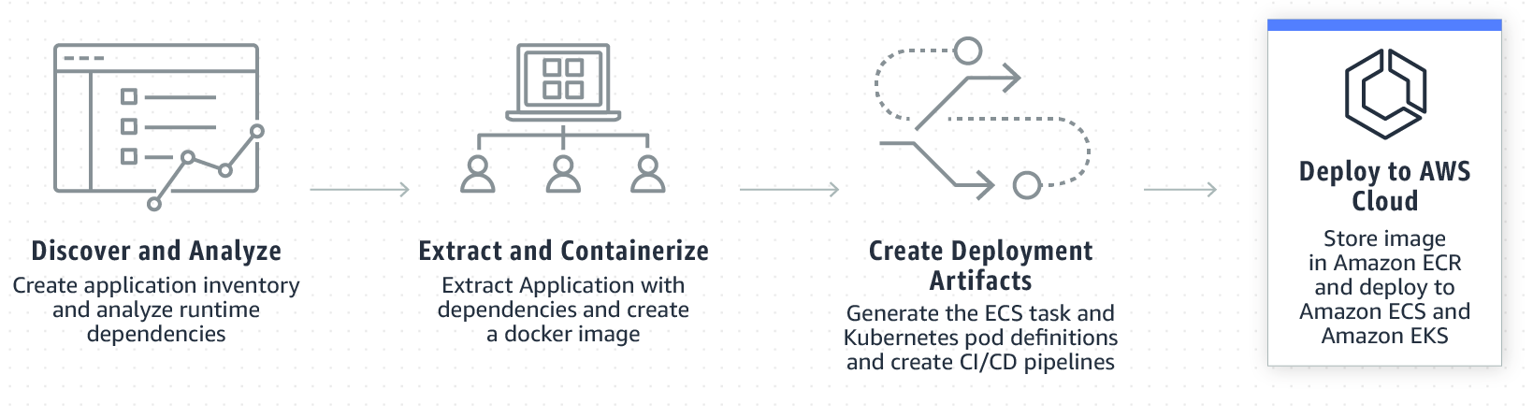
App2Container
App2Container
Containerize and migrate existing applications
Streamline operations by containerizing your existing applications and standardize on a single set of tooling for monitoring, operations, and software delivery.
Analyze your applications and automatically generate a container image that is configured with the correct dependencies, network configurations, and deployment instructions for ECS or Kubernetes.
Easily deploy an existing application on the cloud that is provisioned with the correct networking and security configurations.
https://aws.amazon.com/app2container
Notes:
App2Container enables you to containerize existing applications and migrate them to Amazon Elastic Container Service and Amazon Elastic Kubernetes Service, complete with all the needed dependencies and network configuration.

Slide 27
How can I move from .NET Framework to .NET?

Slide 28
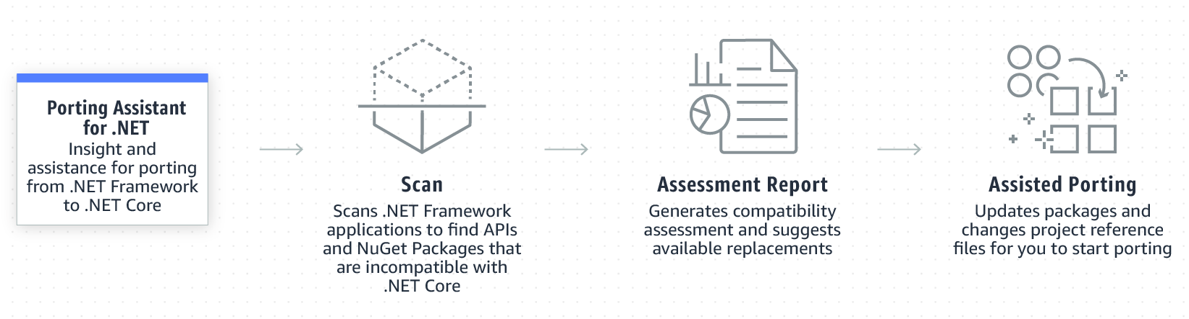
Porting Assistant for .NET
Porting
Assistant
for .NET
Insight and assistance for porting from .NET Framework to .NET Core/.NET 5+
Scan your entire .NET Framework application portfolio to generate .NET Core compatibility assessment reports. This makes it easy to prioritize applications for porting based on the level of effort required.
Identify incompatible .NET Core APIs and packages from your .NET Framework applications, and find known replacements reducing the manual effort of searching for replaceable packages and APIs.
https://aws.amazon.com/porting-assistant-dotnet
Notes:
For those of you with .NET Framework applications, the Porting Assistant for .NET is a free graphical tool that analyzes your application to determine its compatibility with .NET Core or higher.
Going beyond a compatibility report, the Porting Assistant can also automatically port your project files, and update NuGet package dependencies for you, including suggesting compatible replacements.
It offers a real helping hand to when modernizing your applications from .NET Framework onto .NET Core, and .NET 5 or higher.
The Porting Assistant is available as a standalone application or as an extension for Visual Studio, available on the Visual Studio marketplace.

Slide 29
How can I break my .NET monolith?

Slide 30
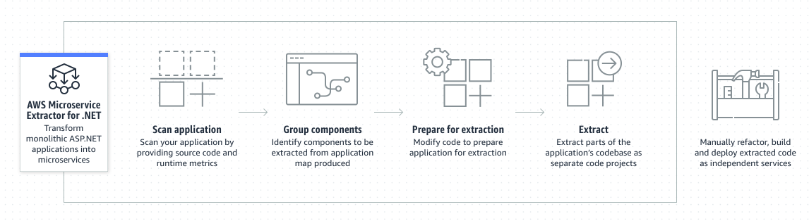
Microservice Extractor for .NET
Microservice Extractor for .NET
Simplify refactoring .NET applications
Quickly identify applications components to refactor into smaller services using a single visualization that shows each component's metrics and dependencies.
Label the visualization to associate code with business processes, making it easier to refactor following Domain Driven Design.
Refactor monolithic codebases into smaller code projects for teams to independently develop, build, deploy, and operate.
https://aws.amazon.com/microservice-extractor/
Notes:
The Microservice Extractor for .NET is a free tool that helps simplify and automate parts of the process involved in refactoring ASP.NET monolithic applications into independent services.
Once extracted, those services can be independently scaled when they’re deployed to the cloud.
Development teams working on the services are then also able to develop and deploy with increased agility and flexibility.
The tool analyzes source code and runtime metrics to create a visual representation of your application and its dependencies, and assists in code refactoring and extraction of the codebase into separate projects.
It also updates the original monolithic codebase for you, to make calls to the extracted microservice.

Slide 31
Wrap up

Slide 32




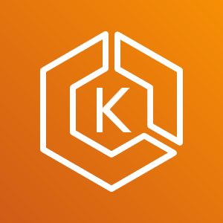
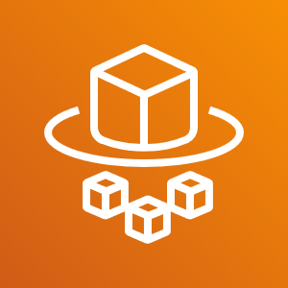

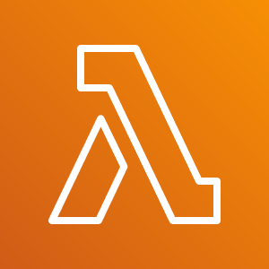
AWS Compute Services for .NET
.NET Framework
Amazon EC2
AWS Elastic Beanstalk
Amazon Lightsail
Amazon Elastic Container Service
Amazon Elastic Container Service for Kubernetes
AWS Fargate
AWS App Runner
AWS Lambda
.NET

Slide 33
Don’t forget the most important key takeaway
.NET

Slide 34

List of interesting links, click away!!!
Isaac Levin
Follow me on Twitter/Twitch/GitHub
@isaacrlevin

